Slide 1
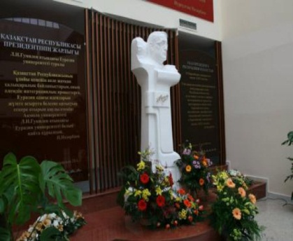
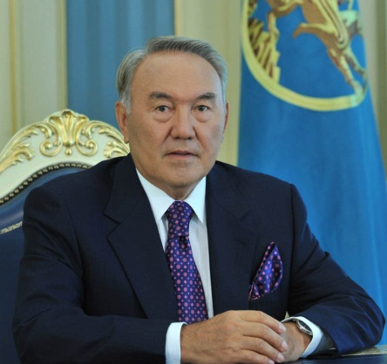
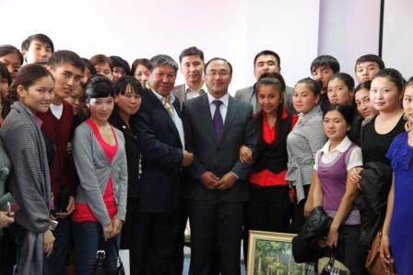
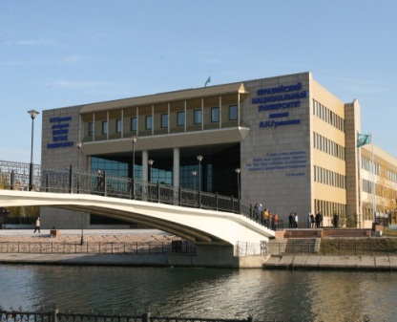
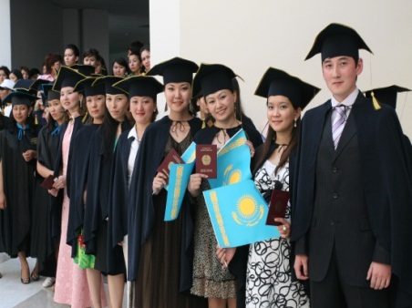
L.N. Gumilyov Eurasian National University
Nurmanbetova D.N. – First Vice-rector of L.N. Gumilyov Eurasian National University

Slide 2
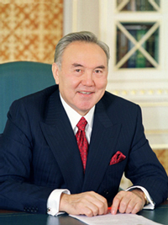
«Qualitative education must become a foundation of industrialization and innovative development of Kazakhstan»
N.Nazarbayev
Founding the university and giving it the name of the greatest eurasianist of Lev Nikolaevich Gumilyov we pursued quite pragmatic goals. ENU is an embodiment of Eurasian ideas, it is a university of future. It’s a diamond in the crown of integrated processes, which is today required by globalization...
I constantly watch over the improvement of ENU and in future we will control the students of ENU to be highly qualified specialists and work for the benefit of our motherland Republic of Kazakhstan...

Slide 3
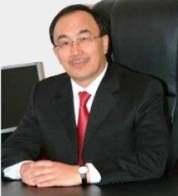
Rector of L.N. Gumilyov ENU
Yerlan Sydykov
Since the day of its establishment, ENU has been provided by the foundation for further development as a national research university with high-class educational and scientific programs, which are based on education quality assurance and scientific research and on the capability of the university to transform ideas into actions and actions into exploitation.
Main privilege of the university in competing is related to the human potential development, in particular – with development of educational level of the population. It is in the sphere of education in which there is a key to sustainable economic improvement of the country at the present stage.

Slide 4
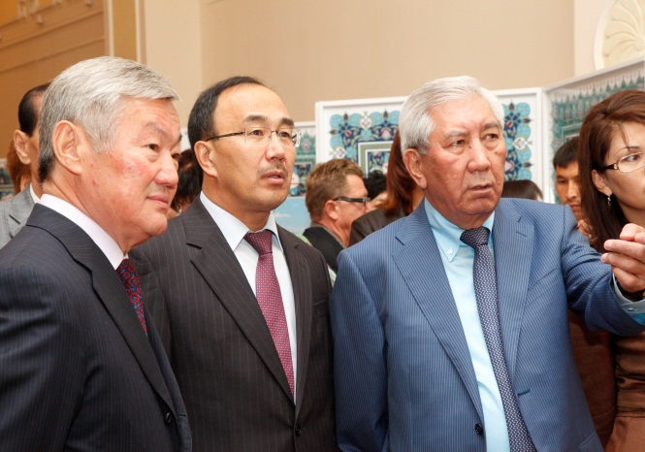
L.N. Gumilyov Eurasian National University
As a result of international acknowledgement of L.N. Gumilyov Eurasian National University are considered the indicators of various international ratings:
- entering top-450 leading universities of the world according to the international rating “ QS World University Rankings 2012– Top Universities” (the place in the cluster is-450);
- 2318th place from 12000 positions in one of the authoritative ratings in international educational sphere – Webometrics (the first Kazakhstani university to take such a high position).

Slide 5
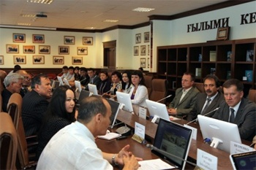
L.N. GUMILYOV EURASIAN NATIONAL UNIVERSITY
Presently, there are 12 specialized faculties, that conduct training for 64 majors at undergraduate level, 65 majors at graduate level, and 29 PhD majors.
More than 12 000 students study at the University. It is the leading university among the HEIs of Kazakhstan as regards to the number of state educational grant holders, the number of honourable decoration "Altyn Belgi" holders, and the winners of international and national competitions.
The educational process is maintained by more than 2000 highly qualified teaching staff.

Slide 6
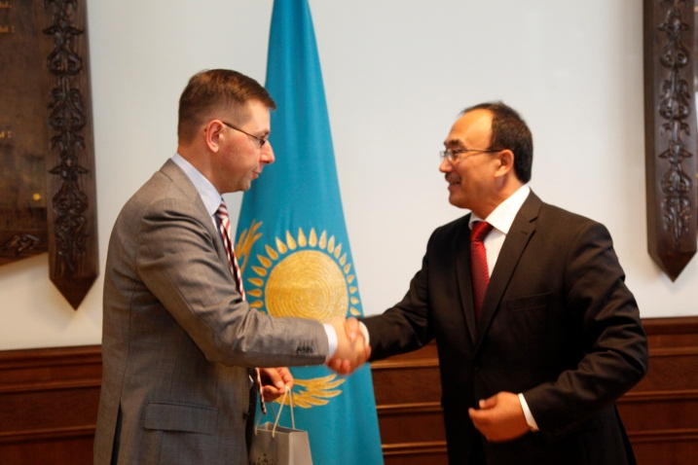
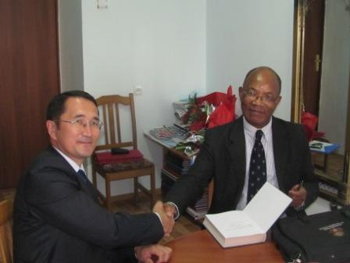
L.N. GUMILYOV EURASIAN NATIONAL UNIVERSITY
ENU has more than 150 active agreements with the universities, research centers and other educational and research institutions of the EU, the USA, Oceania, Asia, Africa and CIS.
Conditions have been created to increase the attractiveness of ENU as a great discussion platform for the various scientific conferences and round tables, lectures, seminars and trainings for many politicians and state figures from various countries.

Slide 7
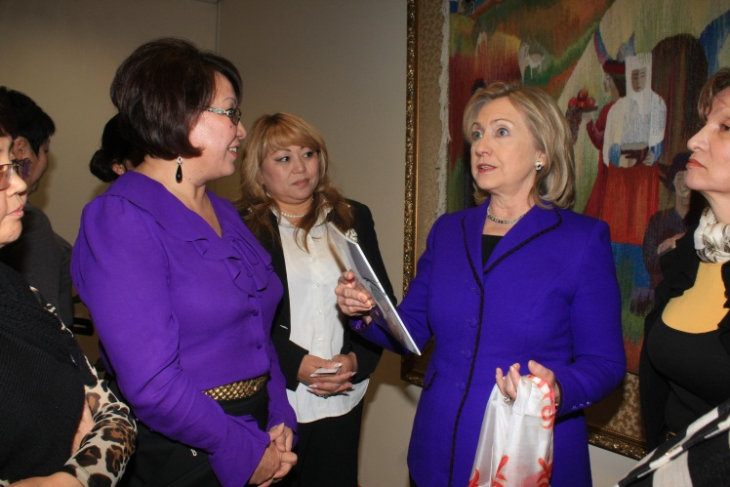
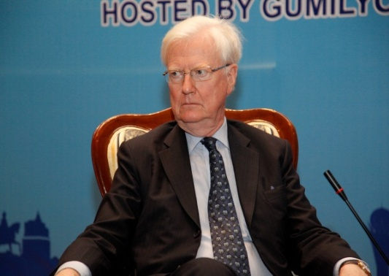
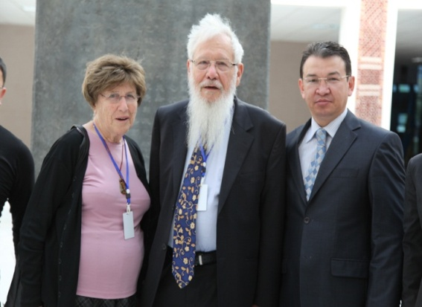
L.N. GUMILYOV EURASIAN NATIONAL UNIVERSITY
Heads of states, prominent politicians and international figures attend ENU to deliver their lectures.
In 2011, Nobel Prize winners - Robert Aumann (Nobel Prize in Economics, 2005), Roger Kornberg (Nobel Prize in Chemistry, 2006), John Nash (Nobel Prize in Economics, 1994) and James Mirrlees (Nobel Prize in Economics, 1996) read lectures for the students of ENU.

Slide 8
L.N. GUMILYOV EURASIAN NATIONAL UNIVERSITY
One of the important criteria for the quality assurance and attractiveness of the university is the international accreditation of study programs. September 29, 2009 ENU obtained institutional accreditation of the Hashemite Kingdom of Jordan in the field of higher education. In the 2010-2011 academic year, the RAEE Accreditation Centre (Russia) accreditation certificates of 6 technical study programs (Bachelor’s and Master’s) were received for a period till 2016. July 12, 2012 10 study programs in social and humanitarian sciences were certified in the international accreditation agency ACQUIN (Germany).

Slide 9
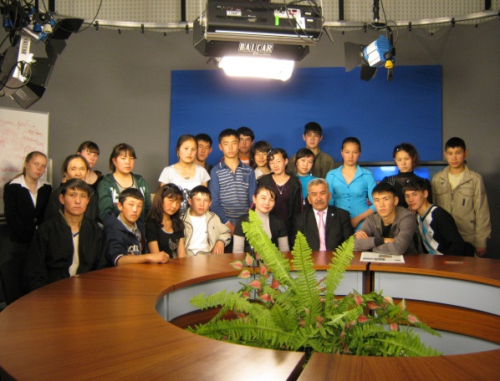
L.N. GUMILYOV EURASIAN NATIONAL UNIVERSITY
Eurasian National University attaches great importance to the national-cultural, spiritual, moral, aesthetic, patriotic education of students, which means it is not only educational, scientific, but a cultural center. Teaching and education is a unified process aimed at forming highly educated, erudite and creative professionals.

Slide 10
THANKS FOR YOUR ATTENTION!

