Slide 1
Slovak University of Technology in Bratislava www.stuba.sk
Faculty of Civil Engineering
www.svf.stuba.sk
Valeria Lesnakova
Gabriela Pavlendova

Slide 2
Slovakia is situated in the central Europe
Poland
Czech Republic
Ukraine
Austria
Hungary

Slide 3
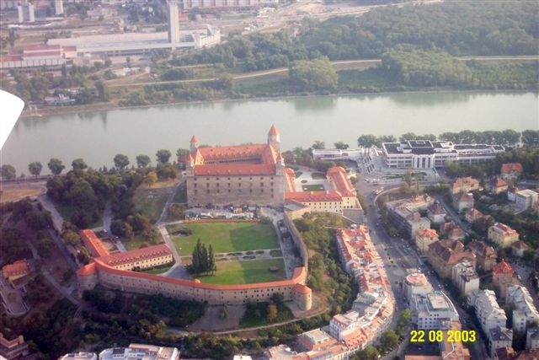
Bratislava is the capital of Slovakia

Slide 4
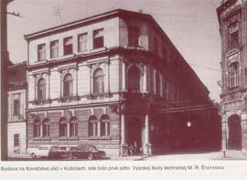
History
Slovak University of Technology (STU) was founded in Košice and authorised by the Act No. 170/1937 Coll. of the Czechoslovak National Council, on June 25, 1937 as the
Technical University
of M. R. Štefánik

Slide 5
STU in numbers
112.000 graduates
19.000 students in all forms of study
1.600 teaching and research staff
7 faculties (schools)
2 institutes
5

Slide 6
Structure of the STU
Faculty of Civil Engineering
Faculty of Mechanical Engineering
Faculty of Electrical Engineering and Information Technology
Faculty of Chemical and Food Technology
Faculty of Architecture
Faculty of Material Sciences and Technology
Faculty of Informatics and Information Technologies

Slide 7
Academic staff
7

Slide 8
Study degrees
3rd DEGREE
Doctoral study
PhD. ArtD.
2nd DEGREE
Master study
Ing. Ing. arch. Mgr. Art.
1st DEGREE
Bachelor study
Bc.
3-4 years
3/5 years
Full-time/part-time
2-3 years
8

Slide 9
Number of students
12566
5141
1350
9

Slide 10
Quality Education Policy at STU
harmonized with Bologna declaration
according to approved document:
Standards and Guidelines for Quality Assurance in the European Higher Education Area:
In English:
Http://www.eqar.eu/fileadmin/documents/e4/050221_ENQA_report.pdf
Translation to other languages:
http://www.enqa.eu/pubs_esg.lasso
10

Slide 11
Quality Education Policy at STU
2006 – rector presented 10 principles for Quality Implementation followed by documents
Principles of Management Quality Education at STU:
see
http://www.stuba.sk/new/generate_page.php?page_id=4564
11

Slide 12
Quality Management Principles at STU
QM principles follow from given
Quality of programms, education and student’s work can
increase permanently
University and faculties have institutional responsibility
for offer and quality of education
Quality education assessment has to be done by
external and internal body

Slide 13
Main Processes for QM
Proposals of new study programs
Harmonization of programs with foreign universities
Approving of the changes in study programs
Evaluation of study programs
Evaluation of study programs by external evaluators
Feedback from students, employers, professional bodies
Final evaluation

Slide 14
Levels in Organisational Structure
Commissions for System of Quality Management of Education at the level of
STU
Faculties of STU
Faculty departments
Subjects studied

Slide 15
The Faculty of Civil Engineering ENROLMENT (2010/11)
Bachelor Study 3003
Master Study 1030
Doctoral Study 274
4407

Slide 16
Accredited Study Programmes Bc. - 8
Geodesy and Cartography
Building Structures and Architecture
Civil and Transportation Engineering
Hydraulic Engineering and Water Resources Management
Environmental Engineering
Civil Engineering (in English language)
Building Technology and Management
Mathematical and Computational Modelling

Slide 17
Accredited Study Programmes Ing. - 12
Geodesy and Cartography
Architectural Constructions and Design
Building Structures
Building Structures and Architecture
Building Services
Technology of Building Environment
Civil and Transportation Engineering
Hydraulic Engineering and Water Resources Management
Environmental Engineering
Building Technology
Mathematical and Computational Modeling
Landscape and Landscape Planning

Slide 18
Accredited Study Programmes PhD. - 9
Geodesy and Cartography
Theory and Construction of Buildings Structures
Theory and Technology of Building Environment
Theory and Construction of Civil Engineering Structures
Water Management Engineering
Applied Mechanics
Building Technology
Applied Mathematics
Landscape

Slide 19
Faculty of Civil Engineering as a leader in Research and Education in the field of Civil Engineering and Geodesy in Slovakia
consists of
21 departments
Institute for Forensic Engineering
Library and Information Centre
Information Technologies Centre

Slide 20
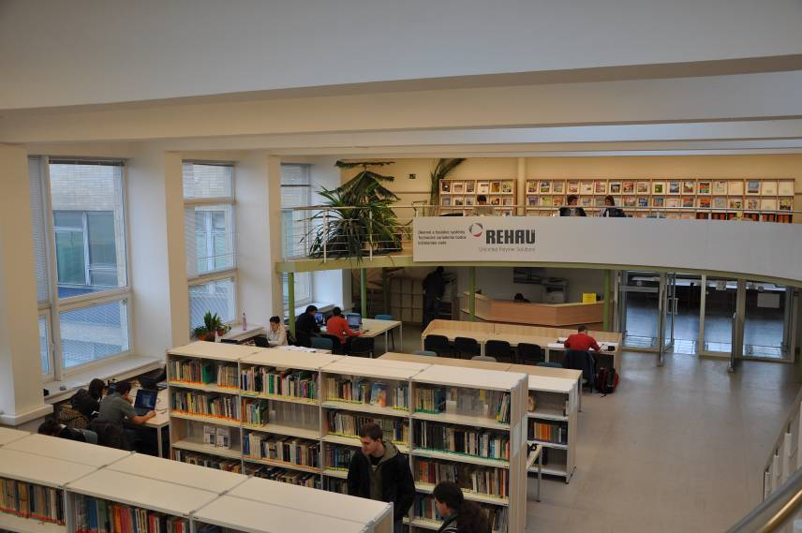
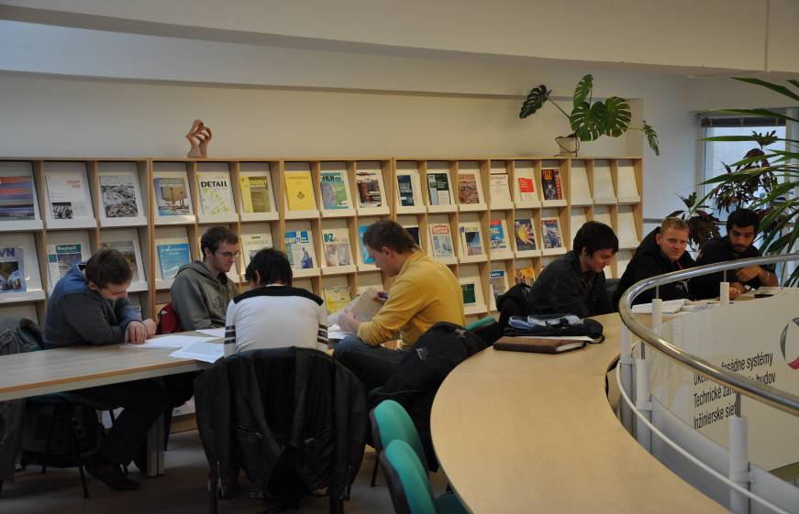
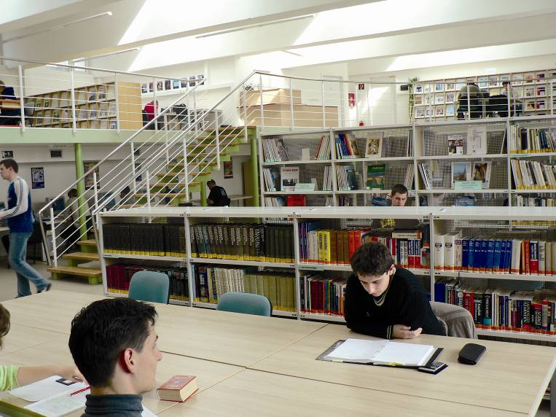
Library and Information Centre

Slide 21
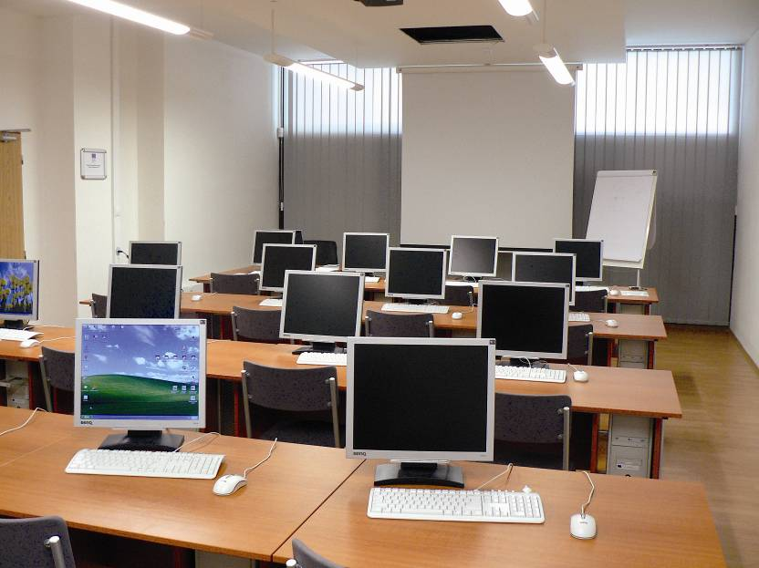
Information Technologies Centre

Slide 22
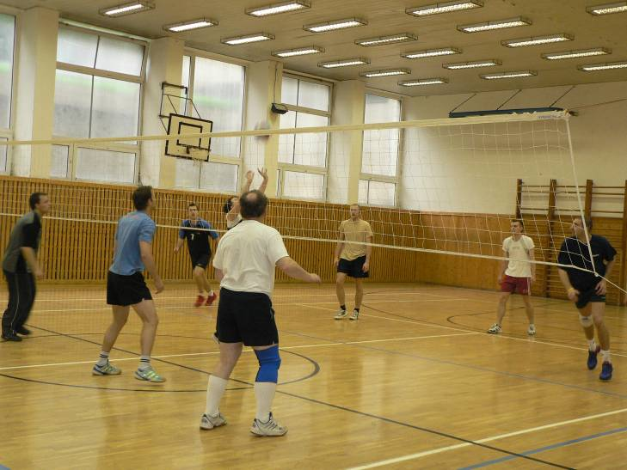
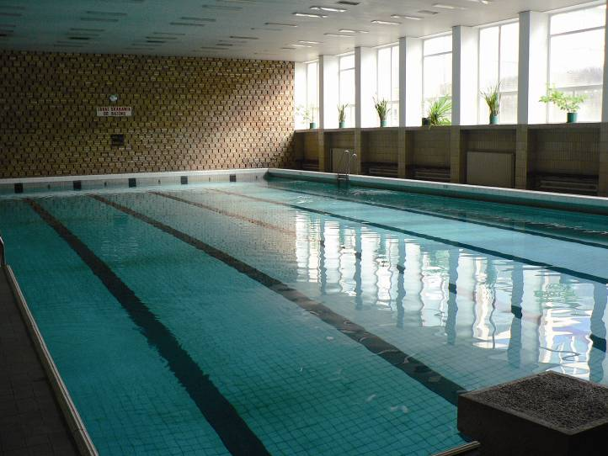
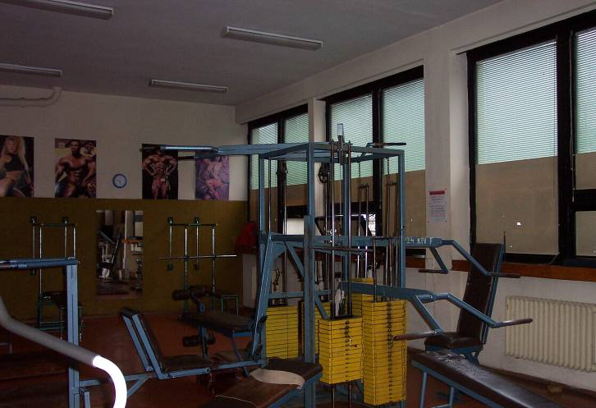
Sport Facilities

Slide 23
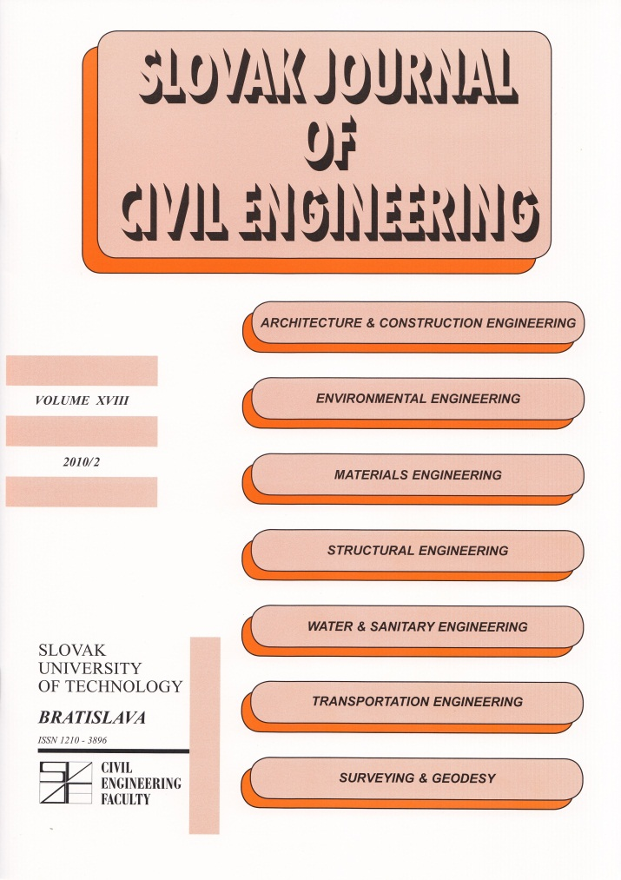
Slovak Journal of Civil Engineering

Slide 24
Quality Assurance of Schools
Law Code 131
Accreditation
Statistical Surveys e.g. ARRA
Activities of the faculty self-government
Activities of the Scientific Board of a Faculty

Slide 25
Quality Education at STU Faculties
System of Education Process Quality management prepared by faculties
Quality Policy at the Faculty
Ensuring Quality of Educational process
Planning the process
Implementation and Monitoring of Quality of Educational process
Objectives, aims, purposes of Quality of Educational process
25
Notes:
Система

Slide 26
Risks by Transformation of Education
Creation of many new schools – quality control versus financing per capita. Can all schools be universities?
Existing schools – balance between the new trends and study programmes according to market demands and bearing in mind the necessity to have good theoretical basis to be flexible to work offers

Slide 27
Risks by Transformation of Education
Dilema of setting criteria for distribution of the funds allocated by the Ministry of Education at individual schools
Criteria and evaluation by Accreditation Committee – who should be the member?
(Trial by Jury?)

Slide 28
Results of Mistakes in Management of Transformation
Description of preferences towards different educational groups in the Slovak labor market

Slide 29
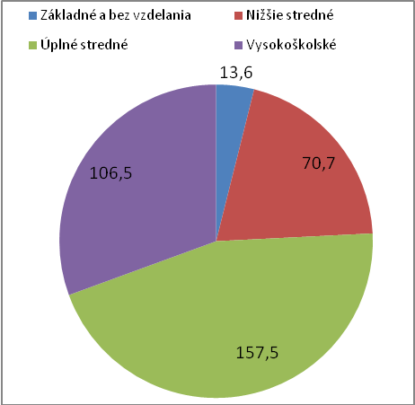
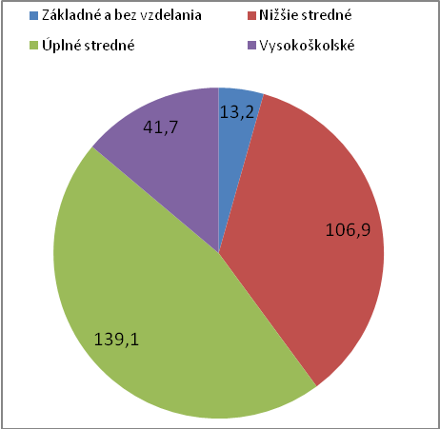
Educational structure of EAO in Bratislava (left) and Trnava (right) region in 2009 (in thousands)

Slide 30
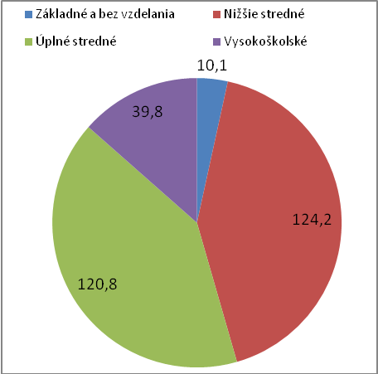
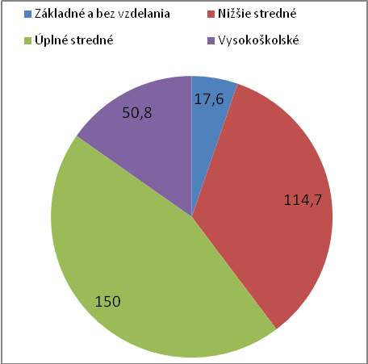
Educational structure of EAO in Trencin (left) and Zilina (right) region in 2009 (in thousands)

Slide 31
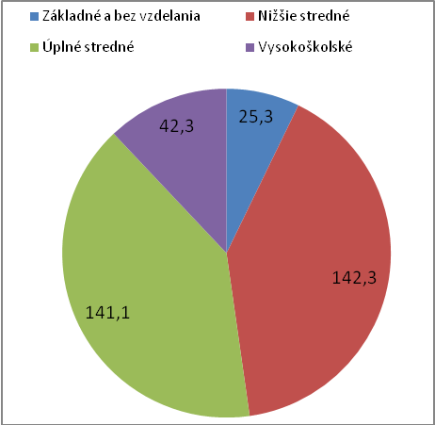
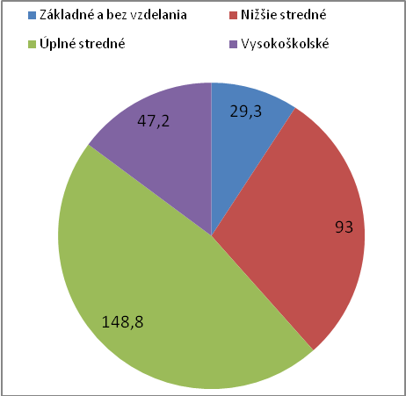
Educational structure of EAO in Nitra (left) and Banska Bystrica (right) region in 2009 (in thousands)

Slide 32
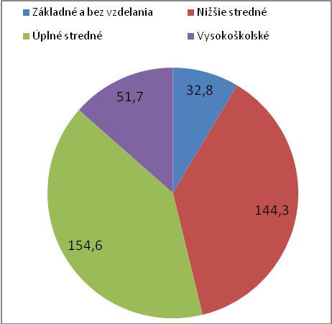
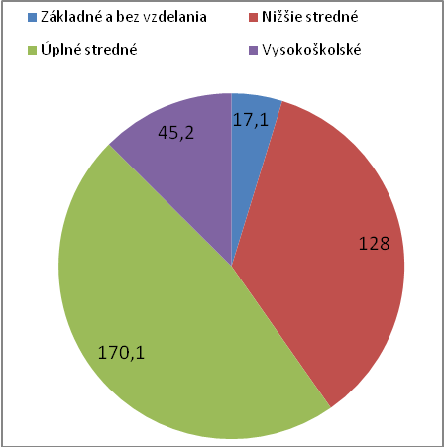
Educational structure of EAO in Presov (left) and Kosice (right) region in 2009 (in thousands)

Slide 33
New students in higher education, as a percentage of the reference year for OECD countries

Slide 34
Offer (blue one) and demand for university education in the Slovak labor market (index changes)

Slide 35
Overqualification of university-educated workers by age group

Slide 36
Development of unemployment rate by academic discipline
Skupina odborov | 2003 | 2004 | 2005 | 2006 | 2007 | 2008 | 2009
Pedagogické, pedagogical | 3,27% | 3,14% | 4,11% | 2,47% | 3,66% | 2,98% | 2,95%
Humanitné, humanities | 2,95% | 5,25% | 5,78% | 6,50% | 7,03% | 7,89% | 3,26%
Spoločenské, social | 5,73% | 6,01% | 4,38% | 3,35% | 4,00% | 3,68% | 3,92%
Prírodné vedy a matematika Natural sciences and mathematics | 10,42% | 5,80% | 5,42% | 4,30% | 5,32% | 3,49% | 3,75%
Technické Technical | 2,74% | 5,44% | 4,67% | 2,62% | 2,50% | 2,36% | 4,44%
Poľnohospodárske Agricultural | 11,80% | 11,19% | 5,56% | 4,38% | 4,56% | 2,69% | 3,51%
Zdravotnícke medical | 0,65% | 1,58% | 1,24% | 0,63% | 0,98% | 1,93% | 2,09%
Služby, service trades | 3,66% | 10,85% | 9,93% | 6,47% | 5,36% | 2,46% | 3,43%
VŠ Spolu, together | 4,63% | 5,46% | 4,67% | 3,18% | 3,64% | 3,20% | 3,58%

Slide 37
Recommendations for policies related to researched problems
Review policies for lifelong learning
to focus specifically on older year of birth with less than secondary education
to support distant learning courses to increase the level of education for the ones born after 1970
Review the method of financing medical fields of study at all levels of education. Themarket demands them,but their study is more expensive. It would be useful to consider the special rules for their financing.
Review the possibility of greater control of course content and number of graduates in some of the less attractive technical but also social science disciplines. More complex analysis focused on differences in attractiveness would be needed to identify the critical fields.

Slide 38
Students and graduate evaluation
Why have the students chosen the particular university? Would they do
the same choice again? What is their opinion on quality of education process,
teachers – do they have sufficient interconnection with real life?
Do the graduates think that their schooling helped them to find a proper
job? How do they (backward-looking) evaluate the university years: was it
usefully spent time? What did the teachers give them – or, are they really
suitable to teach students? Where the skills and knowledge obtained in
university useful in real life?
Employers: how do they choose employees? Are they interested in
which school they graduated from? Graduates of which schools are the most
wanted in the labour market?

Slide 39
Students and graduate evaluation
Quality education was a major reason for school selection for 28.2% of respondents. Under the quality of education these students understand the prestige of the school especially, the fact that there are good teachers at school. Quality education is important for women - female candidate and for students and faculties in Bratislava.
The rest of the students were influenced more by the fact that the school can be completed easily (they were often excepted without entrance examinations, 23.4% of respondents), the study is relatively cheap (close to the place of residence, but rather in smaller regional towns - 23.7%) or good reputation of student life at the school (they went there to study because of their friends and they selected a city rather than the school itself - 24.7%).
Universities do not feel the demand for high quality education from their students and prospective students. They are not under expected pressure and forced to seek the highest quality of schooling provided, on the contrary, it is often enough to reside in relatively attractive city for students and not to make the way to diploma very complicated. It might be one reason of the following results.

Slide 40
To what extent are you satisfied with the level of study at your school? (Students 2006)

Slide 41
Having the possibility to decide whether to start studying at your current faculty or to choose another one will you choose your current school? (Graduates 2009) Interesting fact also is that only 17% of teachers would advise their relatives and friends to study at school they teach at.

Slide 42
You see having formally the rules is not enough
THE DEVELOPMENT OF EDUCATION
National Report of the Slovak Republic
by
Ministry of Education of the SR
July 2004

Slide 43
1. THE EDUCATION SYSTEM AT THE BEGINNING OF THE TWENTY-FIRST CENTURY: AN OVERVIEW
1.1. THE MAJOR REFORMS AND INNOVATIONS INTRODUCED IN THE EDUCATION SYSTEM AT THE BEGINNING OF THE TWENTY-FIRST CENTURY
1.1.1. The legal framework of education
1.1.2. The organization, structure and management of the education system
1.1.3. Curricular policies, educational content and teaching and learning strategies
1.1.4. Objectives and principal characteristics of current and forthcoming reforms

Slide 44
1.2. MAJOR QUANTITATIVE AND QUALITATIVE ACHIEVEMENTS
1.2.1. Access to education
1.2.2. Equity in education
1.2.3. Quality of education
1.2.4. Content of education: major trends and challenges for curriculum development processes
1.2.5. Policy dialogue, partnerships and participation by civil society in the process of educational change
1.3. THE MAIN PROBLEMS AND CHALLENGES FACING THE EDUCATION SYSTEM AT THE BEGINNING OF THE TWENTY-FIRST CENTURY

Slide 45
2. QUALITY EDUCATION FOR ALL YOUNG PEOPLE: CHALLENGES, TRENDS AND PRIORITIES
2.1. EDUCATION AND GENDER EQUALITY
2.2. EDUCATION AND SOCIAL INCLUSION
2.3. EDUCATION AND COMPETENCES FOR LIFE
2.4. QUALITY EDUCATION AND THE KEY ROLE OF TEACHERS
2.5. EDUCATION FOR SUSTAINABLE DEVELOPMENT

Slide 46
Results by ARRA ( Academic Ranking and Rating Agency) for 2011 Criteria EDUCATION
SV1 - The number of teachers per hundred full-time students and part-time students in 2010
SV2 - The number of professors and associated professors on one hundred full-time students and part-time students in 2010
SV3 - The proportion of professors, associate professors and teachers with PhD on the number of all teachers in 2010
SV4 - The proportion of professors and associate professors from all teachers in 2010
SV612 - The ratio of number of registered candidates to the planned number of students in 2010
SV7 - The ratio of enrollment to the number received in 2010
SV8 - The share of foreign students in the total number of full-time students in 2010
SV9 - The share of students participating in ERASMUS and SAIA mobility in the total number of full-time students in academic. year 2009/2010
SV10 - The proportion of graduates employed in the total number of graduates who have obtained degree in 2010

Slide 47
Results by ARRA ( Academic Ranking and Rating Agency) for 2011 Criteria RESEARCH
VV1 - Number of publications in the WoK database for the years 2001-2010 on the creative worker (plus publications from the database CREPČ ( Central Register of Publication Activities) for selected groups of faculty)
VV2 - The number of citations in the WoK database for the years 2001-2010 on the creative worker (plus citations for publications in the database CREPČ for selected groups of faculty)
VV2a - The average number of citations per publication in database WoK for the years 2001-2010 (plus database CREPČ for selected groups of faculty)
VV4a25 - The ratio of the average number of PhD graduates in the years 2008-2010 to the average of all first year students of doctoral studies in the years 2005-2007
VV4b - The share of total scientific output of the faculty for the years 2008-2010 (WoK, respectively CREPČ) per student of doctoral studies

Slide 48
Results by ARRA ( Academic Ranking and Rating Agency) for 2011 Criteria RESEARCH
VV4c - Percentage of total citations of scientific output of the faculty for the 2008-2010 (WOK, respectively CREPČ) per doctoral studies student.
VV5 - The ratio of the average number of daily PhD graduates in the 2008-2010 to the number of professors and associate professors
VV6 - Ratio of the number of full-time doctoral students to full-time students of bachelor and master studies in 2010
VV7 - The amount of grant funding from agencies KEGA VEGA per creative worker in 2010
VV8 - The amount of grant funding from the VEGA agency per creative worker in 2010
VV9 - The amount of funds from foreign grants per creative worker in 2010
VV10 - Amount of grant funds from all the agencies per creative worker in 2010

Slide 49
Thank You !
valeria.lesnakova@stuba.sk
++421 2 592 74 587
project manager
gabriela.pavlendova@stuba.sk

