Slide 1
KHURSHED Teshaev, Technological University of TAJIKISTAN
GENERAL INFORMATION ABOUT QUALITY ASSURANCE OF EDUCATION IN TAJIK REPUBLIC

Slide 2
1. About Tajikistan briefly

Slide 3
1. About Tajikistan briefly
Location: | South-East Central Asia,
Territory | 143.1 thousand km2 (93% - mountains)
Neighboring countries | Uzbekistan (western and northern part; 910 km), Kirgizstan (northern part; 630 km), Afghanistan (southern; 1030 km), China (eastern; 430 km)
Population | 7516, 2 thousand people: Tajik = 68%; Uzbek =23%; Russian =5%; Tatars, Kirgiz and other nationalities
Capital | Dushanbe (1,2 million)
Language | Tajik – State language Russian – Language of the interethnic communication
State holiday | Independence day – September 9th (1991 y.)
Currency | Somoni

Slide 4
2. Some statistics on higher education of RT
Reporting period | Beginning of 2011-2012 academic year
Number of Higher Educational Institutions | 34
Number of students | 167.9 thousand
Female | 53.9 thousand
Students enrolled | 32.4 thousand
female | 11.2 thousand
Specialists qualified | 26.9 thousand
Female | 7.2 thousand
About 10 thousand specialists qualified | 32

Slide 5
2. Some statistics on higher education of RT

Slide 6
3. Main lows and decisions
Constitution of Tajik Republic
Low of Tajik Republic on «Education»
Education reform plan for the period 2004-2014
State program for preparing of specialists on pedagogy in 2005-2012
Low of Tajik Republic on «Higher Professional Education and after university Education»

Slide 7
4. Monitoring of education quality
In 2007 a state service for education control was established
In each university established a department for monitoring of quality assurance
The development of third generation and a three-step level of education program started already
In each university established working groups (committees) for curricula and education program development

Slide 8
5. The credit system of education
Decision of the Ministry of Education of RT № 698 from 22.09.2004, the starting with the 2005-2006 school year at the two universities (TUT, TSUC) introduced a credit system. The system implemented in phases. Already, all students enrolled in the system. All curricula of Bachelor approved and adopted. Postgraduate training programs are at the last stage - getting confirmation.

Slide 9
5. The credit system of education
In organizing the learning process by credit technology the program and curriculum approved by a special decision of the Ministry of Education of RT.
implement the credit system uses three forms of the curriculum for each specialty:
- basic (general specialty) curriculums approved by the Ministry of Education of RT and employees to determine the content and complexity of academic work of each student
- individual training plans drawn up with the participation of the academic adviser (Adviser), and determining the educational trajectory of students
- working plans - is to create an annual schedule of the educational process and the calculation complexity of the training of teachers.

Slide 10
5. The credit system of education
For conversion from hourly labor in loans made following relation Labor: 1 credit = 16 hours of classroom work a semester.
Educational work plans in the field are divided into three sections:
general subjects (containing 74 credits);
basic disciplines (116 credits);
Majors (containing 66 credit)
Total 256 staff on admission to the Bachelor

Slide 11
5. The credit system of education
The following relation of compulsory and elective subjects:
for general studies 75% to 25%;
for basic subjects 60% to 40%:
majors for 55% to 45%.
Individual curriculum for each student is formed in each academic year personally by the student, if necessary with the help of advisors.
The plan approved by the dean of the faculty and stored in the Registration Centre. Approved copy issued to the student.

Slide 12
5. The credit system of education
Universities responsible for all methodological support of educational process. In particular, for each specialty until July 5 to be prepared:
Program of disciplines for students (Sillabus), which include topics and duration of each session;
curriculum on all disciplines (in accordance with the working curriculum) with the complexity of the credits;
materials for classroom work in each discipline: the texts of lectures, seminars plans, practical and laboratory classes;
sets of visual aids and support materials (handouts) for the classroom;
materials of for self-study student under the guidance of a teacher: typing assignments, self-control materials, sample essays, term papers, a list of textbooks and teaching materials in print and electronic forms;
Materials for training and work practices: the plans and programs of the practices, forms, reporting;
students' knowledge control materials of (quizzes on sections of the course, exam tests, tasks, etc)

Slide 13
6. International Education Programs / Projects
Project: "Implementation of the Bologna Process in the Republic of Tajikistan through the reorganization of the Department of External Relations of universities »(IRORG) (completed in January 2010)
Project: "The initiative for higher education in the field of computer science in Central Asia» (HEICA)
Project: "Sustainable water management in Central Asia» (SWAN)
Project Erasmus Mundus "Universities need to Central Asia Research and Innovation."
Project Erasmus Mundus "Translation of the relevant requirements for Global Education and Technology"

Slide 14
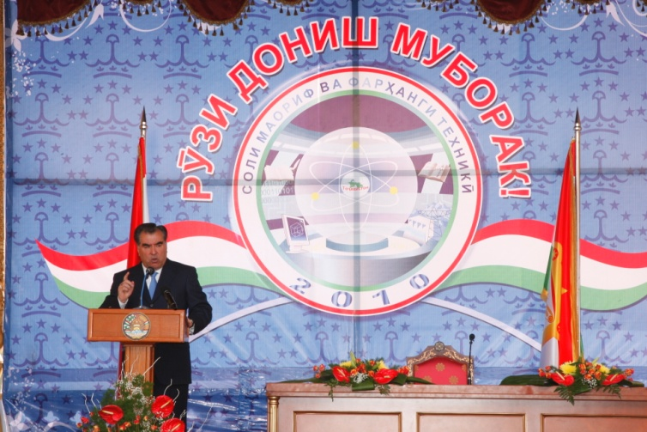
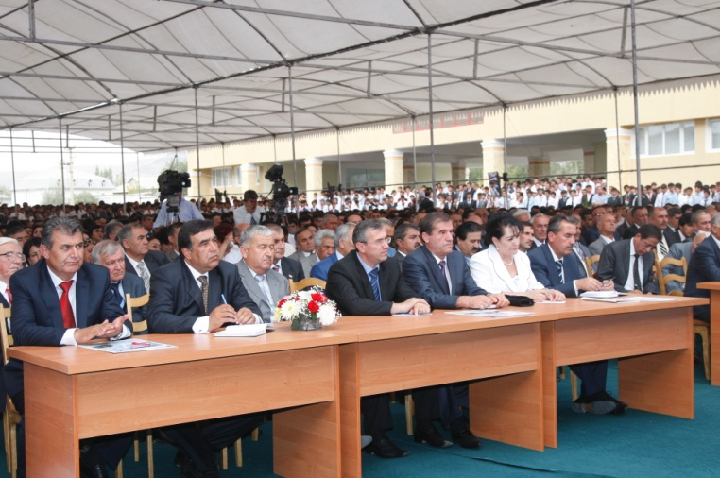
7. The Development Strategy of the Universities until 2020
Improvement of curriculum to the requirements of international standards and complete the transition to a three-step level of education (Undergraduate, Master, Doctoral)
Development a monitoring system of education
Professional development of teachers, improving their mobility and language skills
Masters training in accordance with international standards, participation in programs to improve mobility of undergraduates
Expansion of International Relations at the Universities and receive international accreditation

Slide 15
7.The Development Strategy of the Universities until 2020
The Academy of Sciences
Institutions of higher education
Techno-Parks
Enterprises
Academic Master’s Programs Postgraduate Programs Retraining Programs
Integration, Cooperation and Innovation infrastructure
Joint Projects
Universities

Slide 16
Thanks!!!

