Slide 1
STRATEGIC IMPACT OF THE PROJECT RESULTS AT INSTITUTION LEVEL
Eva Jankovichová
Slovak University of Technology
in Bratislava
Faculty of Civil Engineering
Kyrgyzstan, Bishkek, April 2015

Slide 2
PRESENTATIONS
JANKOVICHOVÁ, E.: Internal Quality Assurance of Study Programmes in Slovak Republic. In: Workshop on Information and Data for Quality Assurance of Study Programmes, L.N. Gumilyov Eurasian National University, Astana, 23 August 2012.
JANKOVICHOVÁ, E.: Strengths and Weaknesses of the Implementation of the Bologna Process in Slovak Republic. In: Training Seminar Methodologies and procedures of definition, gathering, elaboration and presentation of information and data for quality assurance of study programmes: experiences and best practices, Slovak University of Technology, Bratislava, 11 October 2012.

Slide 3
PRESENTATIONS
JANKOVICHOVÁ, E.: Management System and Initiatives for the Promotion of Quality: the Process of Revision and Improvement. In: Training Seminar Methodologies and procedures of definition, gathering, elaboration and presentation of information and data for quality assurance of study programmes: experiences and best practices, Slovak University of Technology Bratislava, 12 October 2012.
JANKOVICHOVÁ, E.: The Revision Process. In: Workshop on Methodologies and procedures of definition, gathering, elaboration and presentation of the identified information and data for the quality assurance of study programmes. Technological University of Tajikistan, Dushanbe, 14 March 2013.

Slide 4
PRESENTATIONS
JANKOVICHOVÁ, E.: Management System and Structural Organisation. In: Training Seminar on Responsibilities and facilities for the definition, gathering, elaboration and presentation of information and data for quality assurance of study programmes: experiences and best practices. University of Alicante, Spain, Alicante, 24-26 April 2013.
JANKOVICHOVÁ, E.: The Process of Revision of the Educational Objectives. In: Training Seminar on Responsibilities and facilities for the definition, gathering, elaboration and presentation of information and data for quality assurance of study programmes: experiences and best practices. University of Alicante, Spain, Alicante, 24-26 April 2013.

Slide 5
PRESENTATIONS
JANKOVICHOVÁ, E.: Implementation of the Bologna Process in Slovakia. In: Training Seminar on Software for on-line management of identified information and data for quality assurance of study programmes in Partner Countries.
Conferenza dei Rettori delle Università Italiane (CRUI), Piazza Rondanini 48 – Roma, 13-15 November 2013.
JANKOVICHOVÁ, E.: Impact of the Bologna process on the Design of SPs in Slovakia. In: Training Seminar on Software for on-line management of identified information and data for quality assurance of study programmes in Partner Countries.
Conferenza dei Rettori delle Università Italiane (CRUI), Piazza Rondanini 48 – Roma, 13-15 November 2013.

Slide 6
Slovak Higher Education System
According to Act No. 131/2002 Coll., on Higher Education
and on Change and Supplement to Some Laws
implements all components of the Bologna Declaration
- three levels that implement the credit system for
assessment
is provided through the accredited study programmes
Source [1]: http://www.astu.tuke.sk/dokumenty/L_131.pdf

Slide 7
Slovak Higher Education System
The Ministry of Education in cooperation with the Higher Education Institutions defined the list of the fields of study for higher education; the accredited study programme may be carried out exclusively in the field of study which has been included in the list of the fields of study.
Source [2]: http://www.minedu.sk/index.php?lang=en&rootId=25

Slide 8
Slovak Higher Education Institutions (HEIs)
autonomous and self-governing
the Act on Higher Education defines the area of competence of various self-governing bodies
HEIs are divided into:
- professional-type (23) and
university-type (18)
- public (20), state (3), private (13),
foreign (5)

Slide 9
Slovak Higher Education Institutions (HEIs)
The representative bodies are:
● Slovak Rectors’ Conference (association of university rectors)
● Higher Education Council (its bodies are elected by the academic senates of HEIs)
● Student Higher Education Council (members are elected by the student parts of the academic senates )
Source [3]: http://www.minedu.sk/index.php?lang=en&rootId=17

Slide 10
The System of Quality Assurance
is based on:
1. internal quality assessment
2. external evaluation
3. accreditation

Slide 11
The Accreditation Commission (AC)
is established by law
is an advisory body of the Government of the Slovak Republic
- does not make decisions, but has the position of an independent professional body that issues standpoints and recommendations
AC carries out accreditation of individual activities of HEIs
- carries out regular complex accreditation of all HEIs in six-year intervals

Slide 12
The Accreditation Commission (AC)
It gives its opinion on capacity of the higher education institution to:
implement the study programme with the right to award to its graduates the academic degree,
In the accreditation of the study programme, an assessment is carried out of the curriculum, student profile, applicant requirements, selection of students, graduation requirements, personnel, material, technical and information provision for the programme, and the educational level of graduates and students of the programme.

Slide 13
The Accreditation Commission (AC)
It gives its opinion on capacity of the higher education institution to:
proposal for granting the State consent for a legal entity wishing to act as a HEI,
to conduct the habilitation procedure and procedure for nomination of professors,
proposals of establishment, merger, affiliation, split, dissolution, change of name or change of seat ,

Slide 14
The Accreditation Commission (AC)
It gives its opinion on capacity of the higher education institution to:
proposal for classification of higher education institutions as research universities, universities and professional higher education institutions,
proposal for change in the system of fields of study,
other proposals with regard to the system of higher education presented by the Minister.
Source [4]: http://www.akredkom.sk/en/

Slide 15
External evaluation of HEIs
• Home Agency
ARRA - Academic Ranking and Rating Agency is an independent Slovak civil association
Source [5] : http://arra.sk/english
• Foreign Agency
Webometrics Ranking of World Universities
- the largest public research body in Spain
Source [6] : http://www.webometrics.info/
http://www.sav.sk/index.php?lang=sk&charset=&doc=services-news&source_no=20&news_no=4388

Slide 16
System of Internal Quality Assurance
The Act on Higher Education stipulates that the HEIs shall also be concerned with quality of teaching as well as their research and creative activities.
Within the framework of complex accreditation, the HEIs also submit an evaluation of their own activities to the AC.
The Scientific Council of the HEI has the responsibility at least once a year to evaluate the level of the educational activities and activities in the field of science, technology or art at the HEI (visitation).

Slide 17
System of Internal Quality Assurance
The students have the right to give their standpoint on the quality of teaching and on individual teaching staff members in the form of anonymous questionnaires at least once a year.
HEIs and their departments make use of self-evaluation for development purposes and in order to identify threats.
The results of these evaluations are not usually published. The assessment reports prepared for the AC by its working groups are made available only to the higher education institution concerned and to the Ministry of Education.

Slide 18
System of Internal Quality Assurance
Beyond the framework of the Act, some higher education institutions have been awarded quality certificates according to the ISO quality norms (e.g., Slovak University of Technology in Bratislava, Faculty of Civil Engineering, University of Technology in Košice), or they implement/introduce the Common Assessment Framework (CAF) system within the framework of the higher education institution or its departments.
Source [7] : GAŠPARÍK, J.: Quality Management System of Educational Process. Bratislava: Slovak University of Technology, Faculty of Civil Engineering, Bratislava 2009, 13 pp.

Slide 19
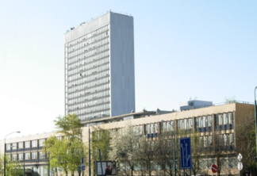
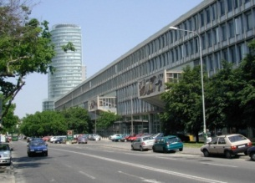
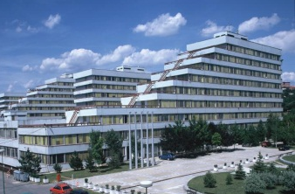
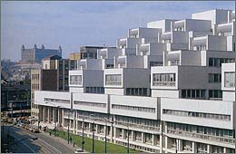
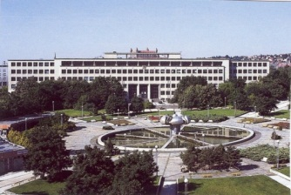
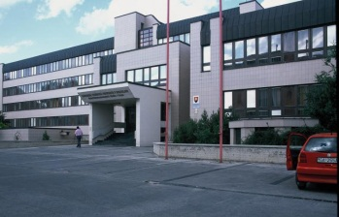
Slovak University of Technology in Bratislava
Faculties and University Centers
Faculty of Civil Engineering
Faculty of Mechanical Engineering
Faculty of Electrical Engineering and Information Technology
Faculty of Chemical and Food Technology
Faculty of Architecture
Faculty of Material Sciences and Technology
Faculty of Informatics and Information Technologies

Slide 20
Slovak University of Technology in Bratislava
Academic year 2013/2014
3rd DEGREE
4
years
2nd DEGREE
Doctoral study
69 study programs
1 547 students
299 graduates
2 years
1st DEGREE
Master study
65 study programs
4 580 students
2 480 graduates
3/4 years
Bachelor study
52 study programs
10 782 students
2 168 graduates
20

Slide 21
Internal Quality Assurance - Challenges
Broad schemes for organizing internal quality assurance policies can be found at all HEIs in questionnaires and databases, along with self-evaluation reports (for complex evaluation) figure among the major implementation instruments.
Institutional quality assurance policies are still more based on inputs (staff qualifications, infrastructure) than outputs (such as learning outcomes).

Slide 22
Internal Quality Assurance - Challenges
The quality of higher education institutions’ activities is assessed externally by the AC. At the moment, however, there is no interconnection between the internal quality assurance instruments of the institution and the external assessment of quality by the AC.
It is not the basic task of external assessment to assess the instruments used for internal quality assurance and improvement.

Slide 23
Internal Quality Assurance - Challenges
Policies on quality assurance can be identified
as follows:
Heavily top-down oriented implementation style
The very top-down orientation of internal quality assurance policies may be the barrier to their effective implementation in traditionally decentralized institutional settings.

Slide 24
Internal Quality Assurance - Challenges
Policies on quality assurance can be identified as follows:
Strong external impact of accreditation measures
Still predominantly input-oriented accreditation procedures - especially staff qualifications – as proxies for quality of educational activities applicable for research and development purposes.

Slide 25
Internal Quality Assurance - Challenges
Policies on quality assurance can be identified
as follows:
Reactive policy-making, based on the plethora of mandatory administrative (policy) documents
Conducive to formal adoption of goals and missing “follow-through” measures.

Slide 26
Internal Quality Assurance - Challenges
Improving the internal mechanisms of quality assurance within the HEIs is a key task for further development of the whole system of higher education.
Lack of formalization, objectification and evaluation of the efficiency of individual instruments of internal quality assurance are the greatest shortcomings in terms of ESG implementation, though it should be added that the situation varies to a remarkable extent from institution to institution and even from faculty to faculty.

Slide 27
Internal Quality Assurance - Challenges
The national policy, stipulating that all HEIs must perform internal evaluations and make the results public, is understandably rather general, giving HEIs a leeway for implementing internal policies in line with their profile, needs, and development preferences.
In future, it will be necessary to address especially the question of developing internal quality assurance mechanisms for higher education institutions, and a system for monitoring and improving them in the context of the external system for quality assurance.

Slide 28
Internal Quality Assurance - Challenges
Support for quality assurance in the sample encompasses a wide range of initiatives that are grouped under three major headings:
1. Institution - wide and quality
assurance policies
2. Programme monitoring
3. Teaching and learning support

Slide 29
In accordance with the principle of institutional autonomy primary responsibility for quality assurance in higher education lies with each institution, and it is the basis for real accountability of the higher education system in the national system of quality assurance.

Slide 30
Catalyst - Kатализатор
A substance that accelerates a chemical reaction. What helps to speed up the development of sth. (Subst.). "K. social progress."
Вещество, ускоряющее химическую реакцию.
То, что способствует ускорению развития чего-н. ( перен. ).
"К. общественного прогресса ."

Slide 31
Thank you very much
for your attention.
Eva Jankovichová
eva.jankovichova@stuba.sk

